Slide 1
SBOL Visual 2.0
Jacob Beal
SEED 2018
Arizona, June 2018

Slide 2
Diagram Elements
Sequence Feature Glyphs
Molecular Species Glyph
Nucleic Acid Backbone
GFP
pTet
gfp
tetR
Labels
Interactions
Reverse Complement Nucleic
Acid Component Glyphs
Grey text and lines (including this) are annotations

Slide 3
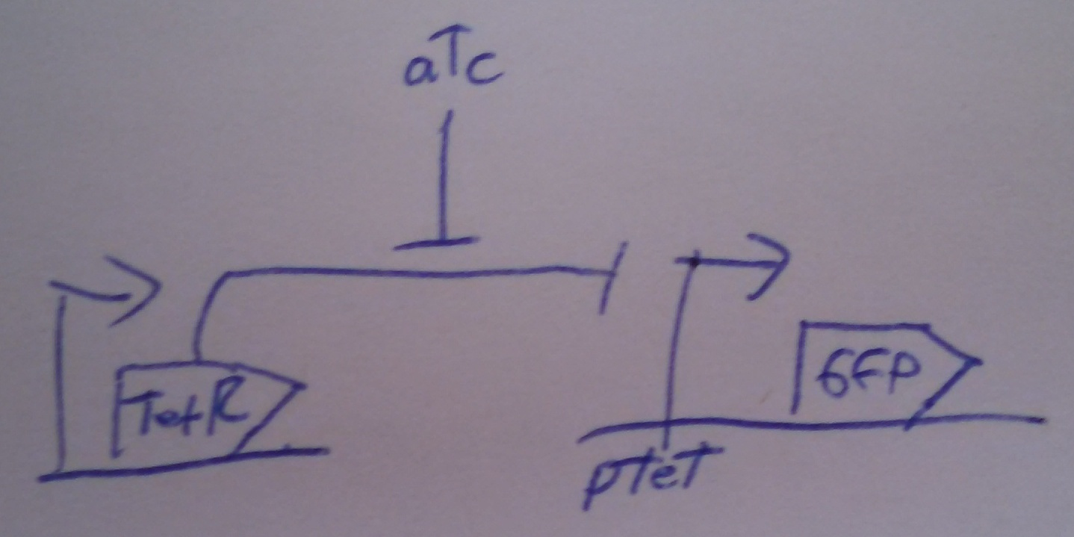
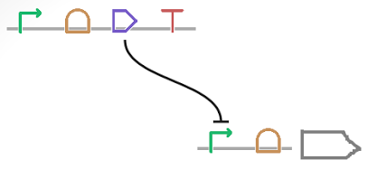
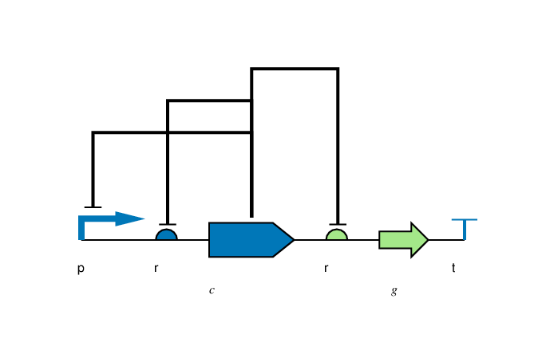
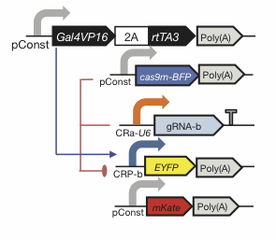
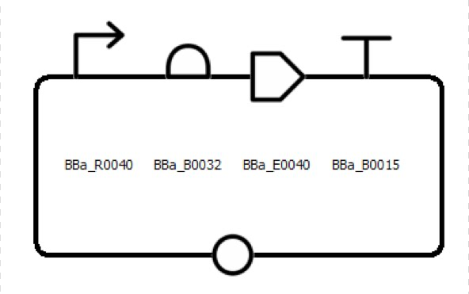
Flexibility of Style
Color, Text, Scaling, Strands, Styling: all your choice

Slide 4
Complex Example Diagram
tetr
J23101
TetR
∅
GFP
∅
gfp
pTet
The top functional unit produces the TetR protein constitutively, under control of promoter J23101. TetR represses the pTet promoter, which is regulating production of GFP. The diagram of GFP production explicitly includes the intermediate mRNA and the degradation of both the mRNA and protein products.

Slide 5
Nucleic Acid Glyphs
recommended alternate
Aptamer
Assembly Scar
Blunt Restriction Site
CDS
Composite
Engineered Region
Sticky End
Sticky Restriction Site
Insulator
No Glyph
Non-Coding RNA
Omitted Detail
Operator
ORI
ORI-T
Poly-A Site
Primer Binding Site
Promoter
Ribosome Entry Site
Signature
Recombination Site
Terminator

Slide 6
Nucleic Acid Glyphs
recommended alternate
DNA
RNA
Protein
DNA
RNA
Protein
Unspecified
Location (recommended)
Location (alternate)
DNA
RNA
Protein
DNA
RNA
Protein
Cleavage Site
Stability Element

Slide 7
Molecular Species & Interactions
Molecular Species
superpose glyphs
alternate
recommended alternate
Complex
Macromolecule
No Glyph
Nucleic Acid (Generic)
recommended alternate
Nucleic Acid (1-Strand)
Nucleic Acid (2-Strand)
Small Molecule
Unspecified
Interaction
Control
Degradation
Inhibition
Process
Stimulation

Slide 8
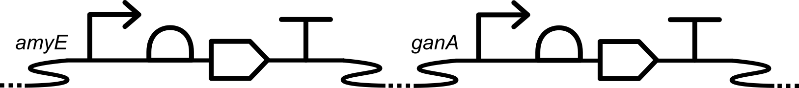

New Genomic Context Symbols
Chromosomal Locus
Circular Plasmid

Slide 9
Making SBOL Visual Diagrams
Using your favorite graphics editor:
Many glyphs can be drawn directly
Glyph set available: http://sbolstandard.org/visual/
SVG, PDF, Font
Specialized visualization tools:
VisBOL: http://visbol.org/
GraphViz: http://www.graphviz.org/
DNAPlotLib: https://github.com/VoigtLab/dnaplotlib

Slide 10
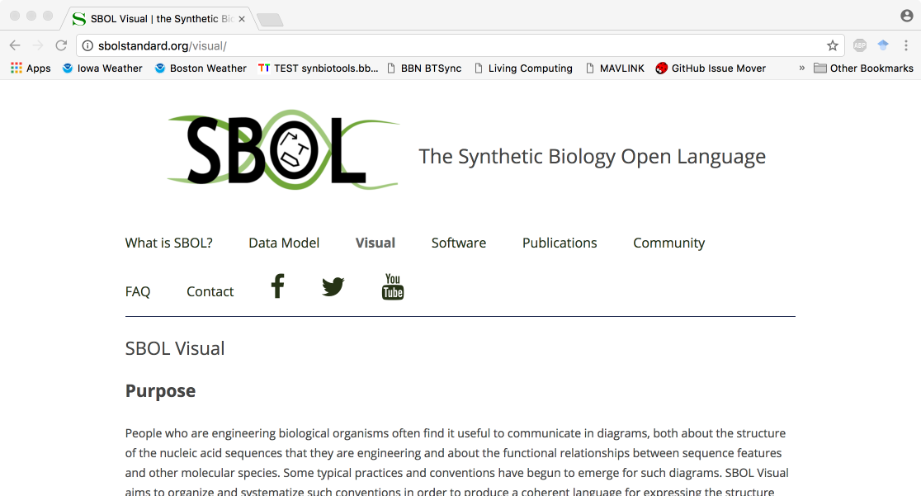
http://sbolstandard.org
Use the symbols in your papers & talks
Contribute opinions, use cases, new symbols
Community is open for anyone to join

